Slide 1
Homework #3 of Introduction to VLSI Design
作業繳交截止日期: April 9, 2025, 23:59 (2 week)
(上傳E3數位平台繳交)
24 hours after the deadline: 20% penalty
48 hours after the deadline: 50% penalty
No submissions accepted after 48 hours
檔名： VLSI_HW3_學號.pdf (VLSI_HW3_112345678)
請將檔案轉成PDF格式 (命名錯誤扣5分)
HW 3.2, HW 3.3, HW 3.4 請命名為 ”學號_3.2.sv”, ”學號_3.3.sv”, ”學號_3.4.sv”
將3個*.sv檔壓縮成”學號.zip”上傳至E3平台
在HW 3.2, HW 3.3, HW 3.4的.sv檔中禁止使用 ”+, -, *, /” 運算符號
可以使用 ”&, |, ^, !” (bit AND, OR, XOR, NOT) 或是 “&&, ||, ~” (logic AND, OR, NOT)
Module 的命名請按照規定的名稱，Port順序以及Port bit數

Slide 2
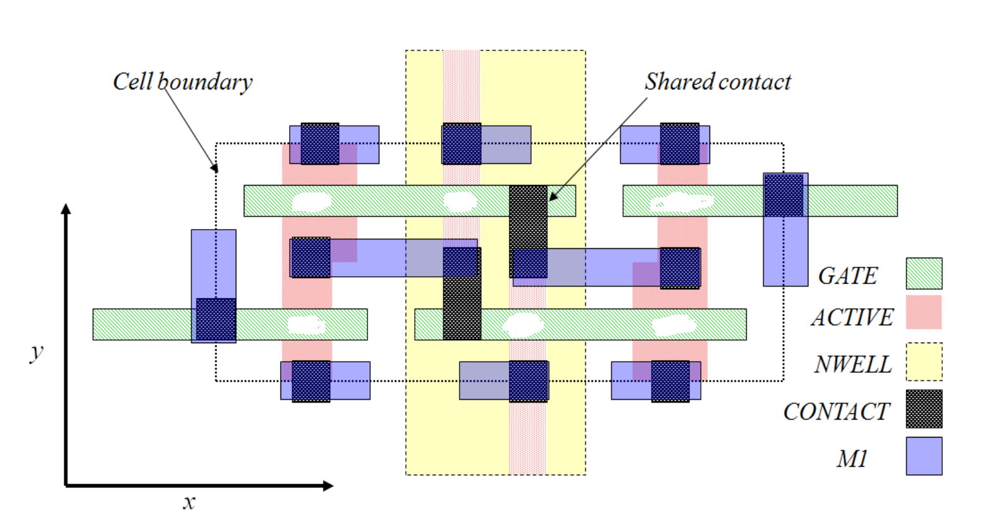
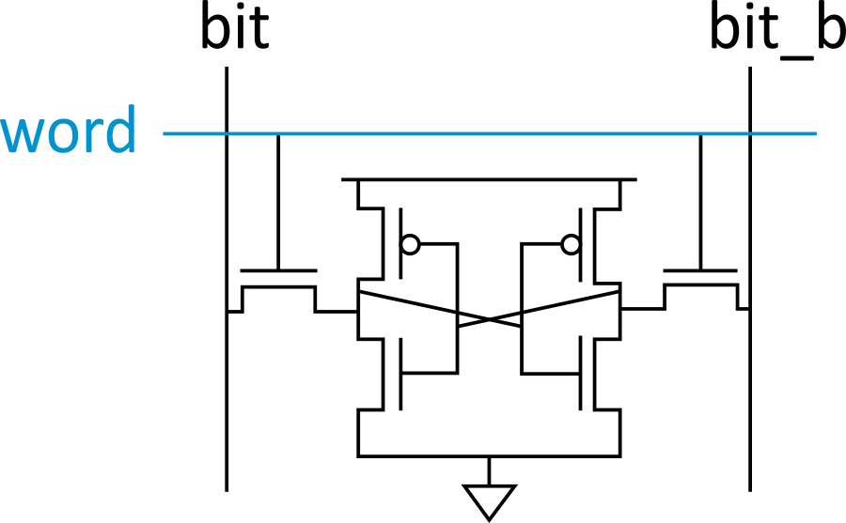
Assignment #3.11 10%
Annotate the labels for the following layouts
word, bit, bit_b, N1,N2,N3,N4,P1,P2
P1
P2
N3
N4
N1
N2

Slide 3
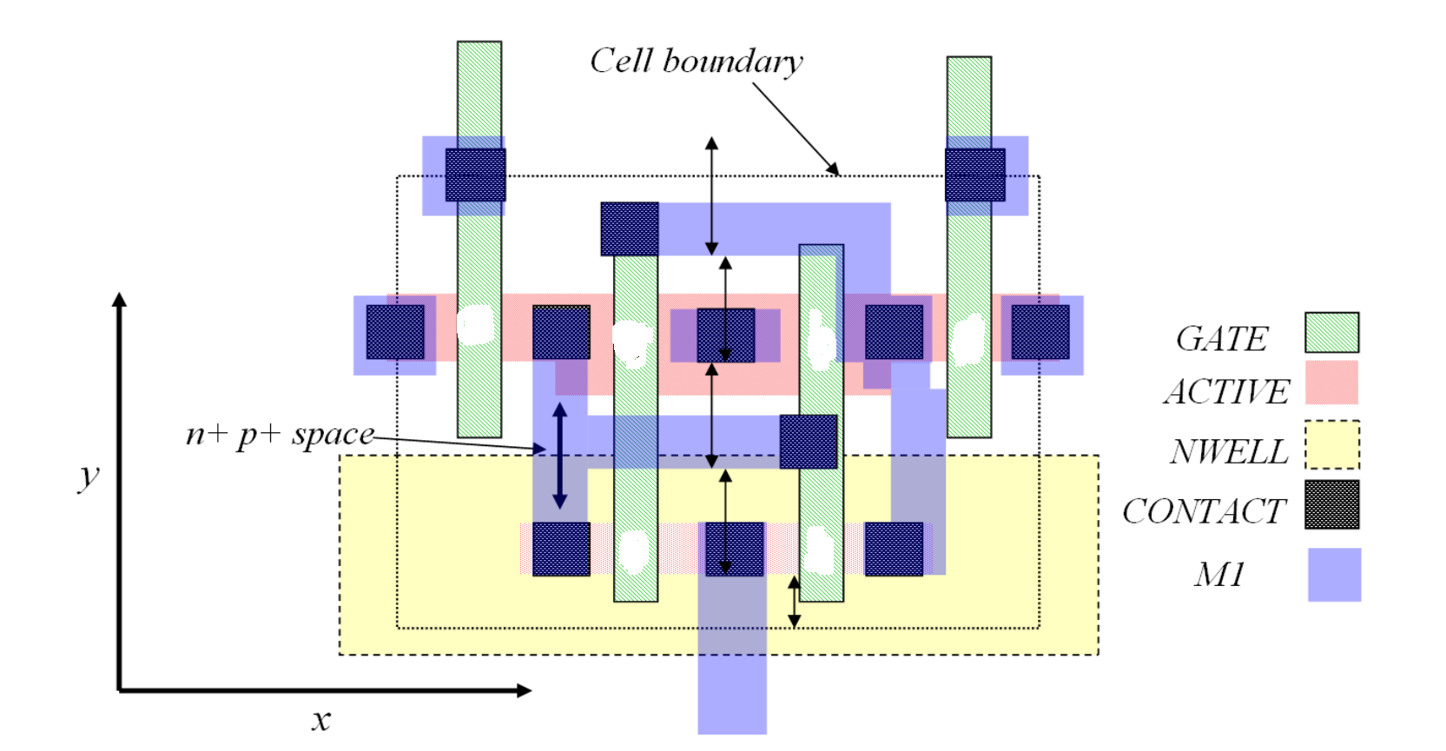
Homework #3.12 (Cont’d) 10%
P1
P2
N3
N4
N1
N2

Slide 4
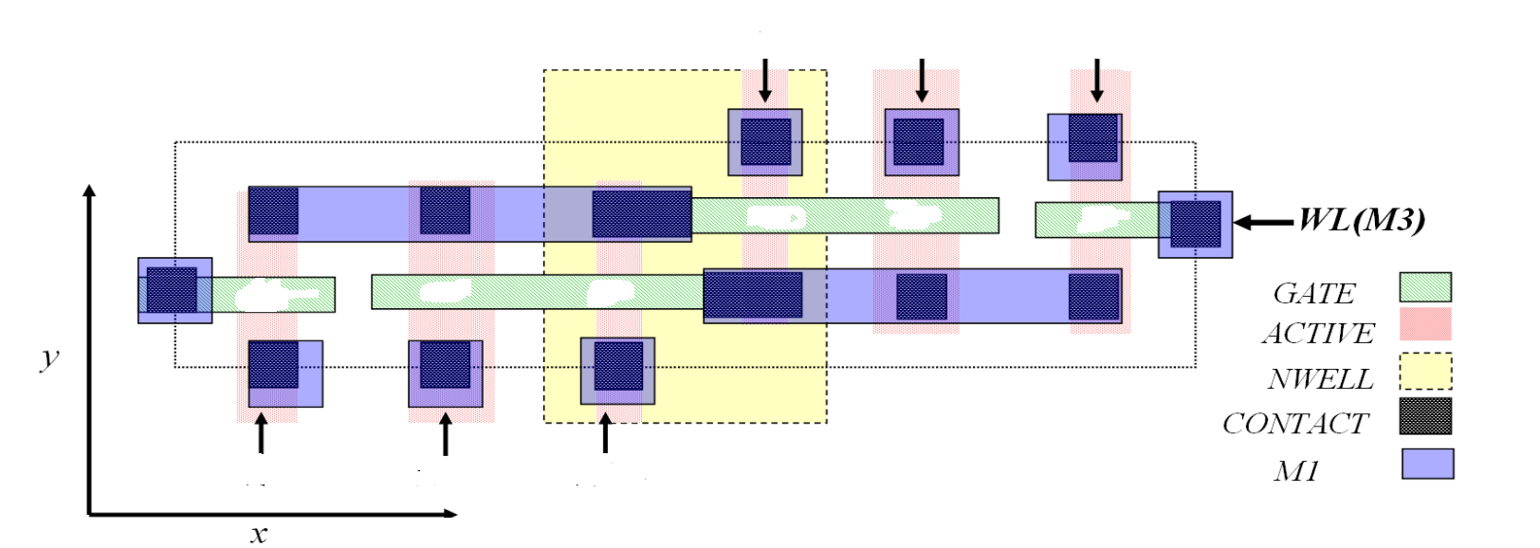
Homework #3.13 (Cont’d) 10%
P1
P2
N3
N4
N1
N2

Slide 5
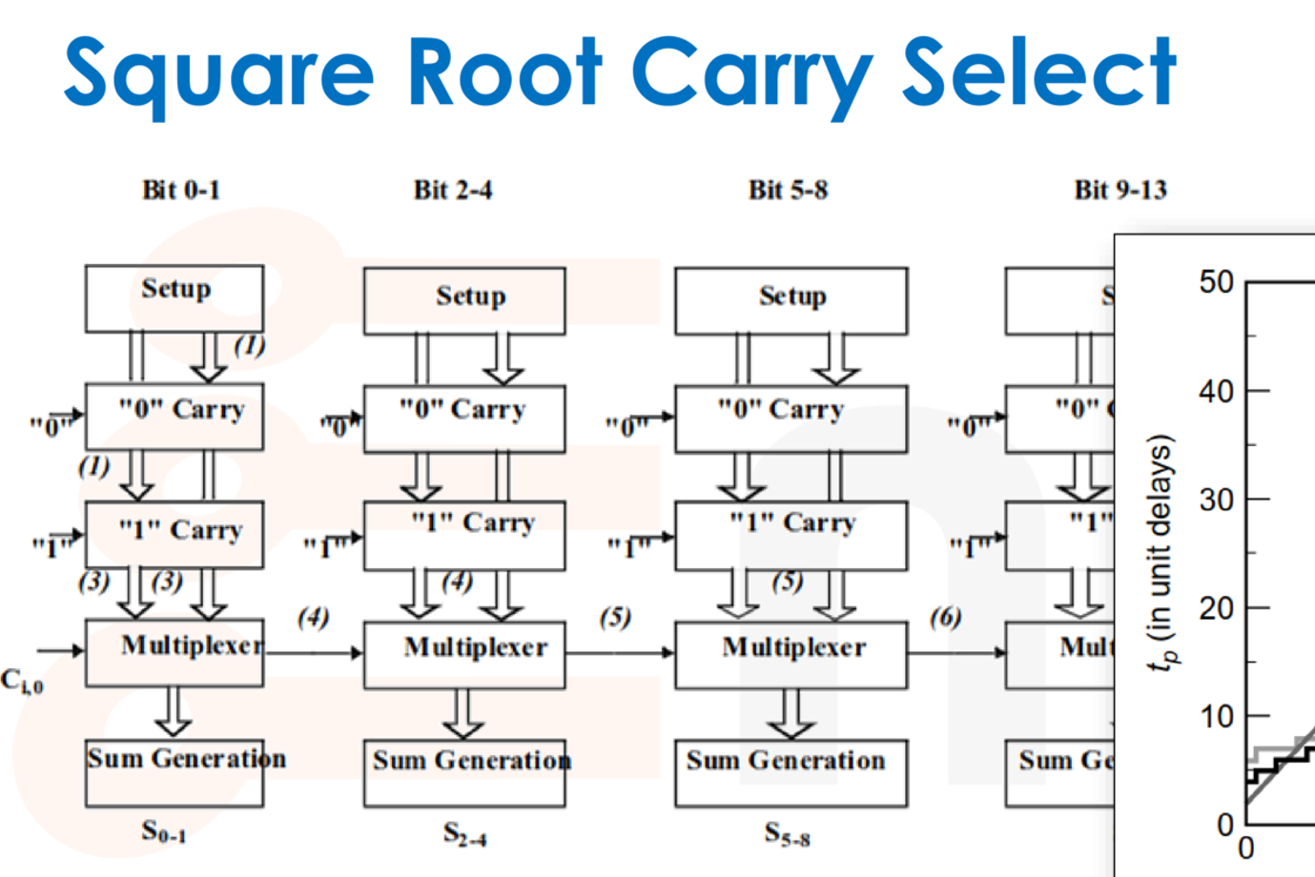
Assignment #3.2 20%
Implement a 14-bit carry select adder with Verilog
Module name:
module CSA_14 (
output logic [13:0] s_o,
output logic c_o,
input logic [13:0] a_i,
input logic [13:0] b_i,
input logic c_i
);

Slide 6
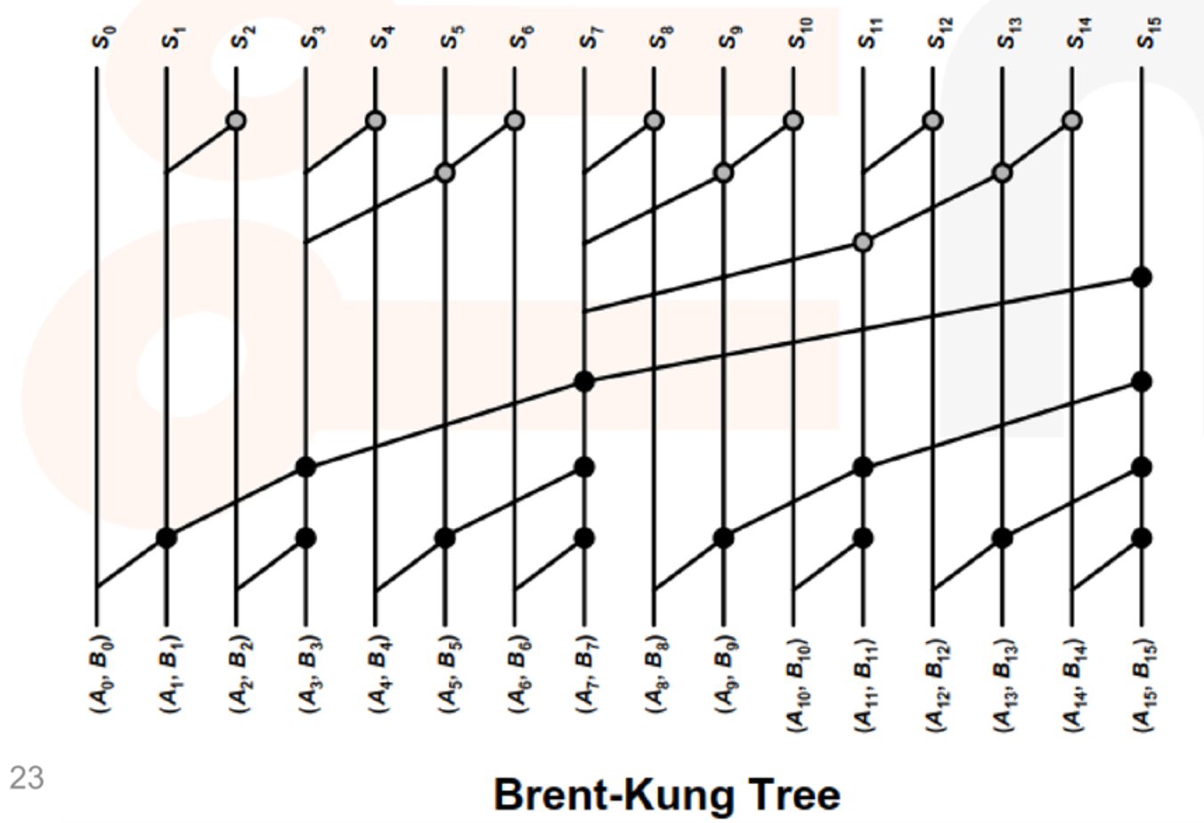
Assignment #3.3 25%
Implement a 16-bit Brent-Kung tree adder with Verilog
Module name:
module BKT_16 (
output logic [15:0] s_o,
output logic c_o,
input logic [15:0] a_i,
input logic [15:0] b_i
);

Slide 7
Assignment #3.4 25%
Implement a 9-bit by 7-bit Wallace tree multiplier with Verilog and please use the implementation of assignment #3.3 (brent-kung tree adder) as the last stage CLA
Module name:
module Wallace_Tree_9X7 (
output logic [15:0] out,
input logic [ 8:0] a_i,
input logic [ 6:0] b_i
);

Slide 8
Reference
EDA playground Examples
Ripple carry adder (https://edaplayground.com/x/YrzV)
Carry select adder (https://edaplayground.com/x/AtHz)
4x4 Wallace-tree multiplier (https://edaplayground.com/x/WkNg)

Slide 9
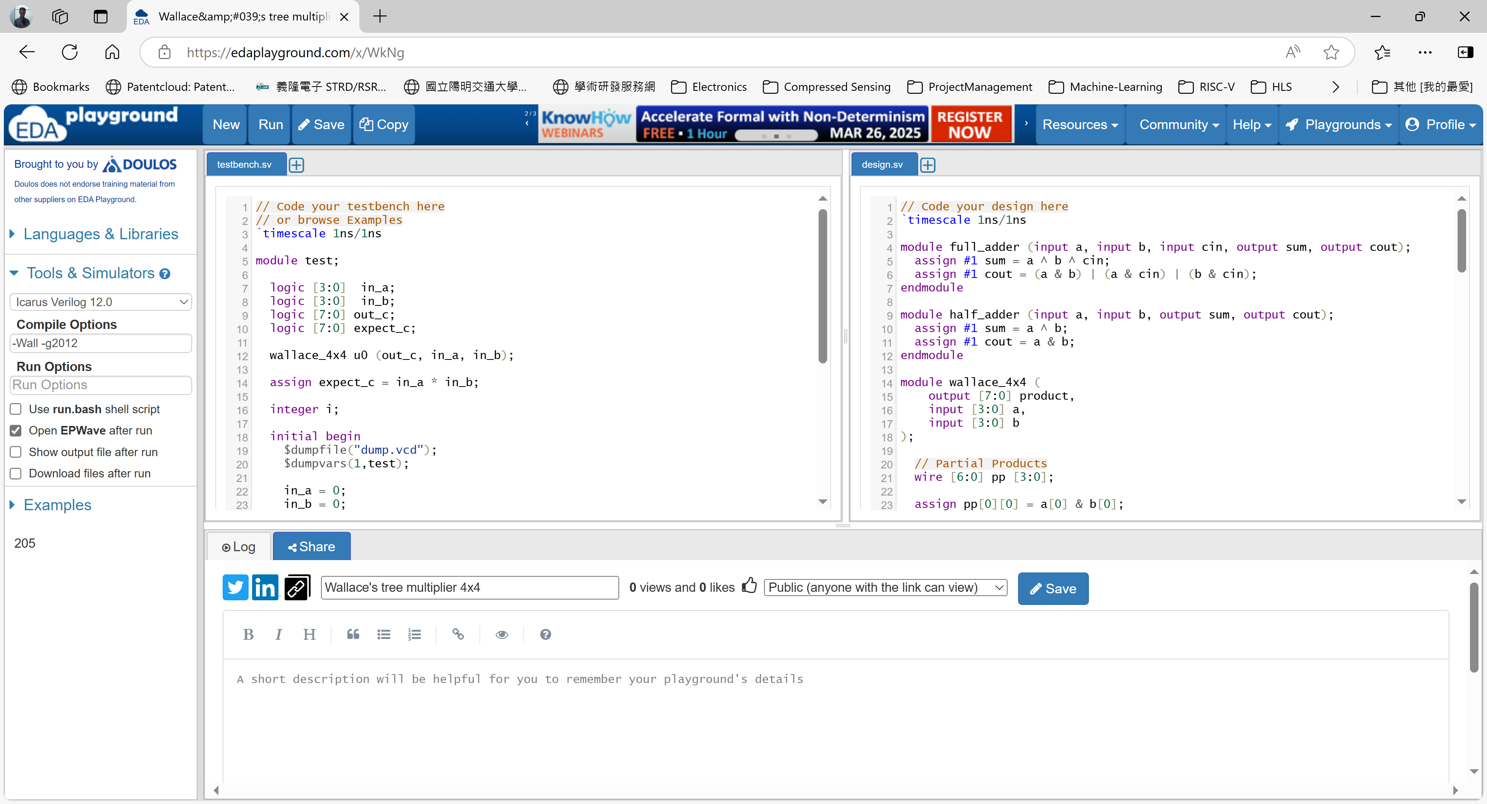
Reference
Run simulation
Save design
Testbench window
Design window
EDA playground UI
Simulator
selection
Enable
waveform
viewer

Slide 10
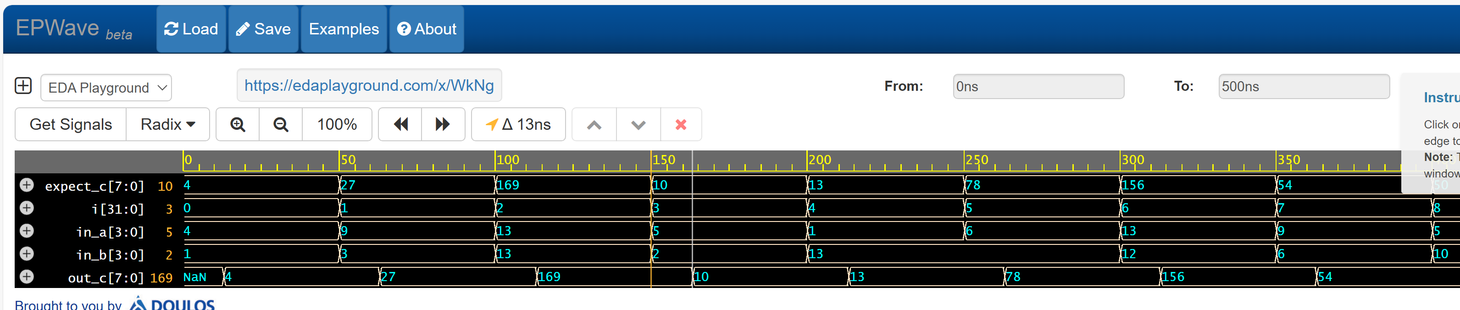
Reference
Waveform viewer

Slide 11
References
Time unit is 1ns
`timescale 1ns/1ns
module test;
logic [3:0] in_a;
logic [3:0] in_b;
logic [7:0] out_c;
logic [7:0] expect_c;
wallace_4x4 u0 (out_c, in_a, in_b);
assign expect_c = in_a * in_b;
integer i;
initial begin
$dumpfile("dump.vcd");
$dumpvars(1,test);
in_a = 0; in_b = 0;
for (i=0; i<10; i=i+1) begin
in_a = $random%16; in_b = $random%16;
# 50;
assert(out_c==expect_c) else begin
$error("[FAIL] Output %d != Expect %d", out_c, expect_c);
$finish;
end
end
$display("All tests pass");
$finish;
end
endmodule
Time precision is also 1ns
Signal declaration
Ref.
Model
Excitation
Comparison
DUT
Waveform control
Wait for 50ns

